Slide 1

Stocker
Stock prediction using social media analysis

Slide 2
Project Outline
Stock prices are usually a bit tougher to forecast due to market volatility and social influence on the trend of each stock.
This project provides a high-level overview of the steps involved in using sentiment analysis from tweets to predict stock market movements.

Slide 3
Index
TOPIC NAME | PAGE NUMBER
WHAT WE ARE TRYING TO BUILD | 5
ABSTRACT | 6
BUSINESS USE CASE | 7
IMPORTANT USE CASE | 8
CONCEPTS USED | 9
OUR DATA | 10
HOW WE PROCESSED DATA | 11
ALGORITHMS USED | 12-16
COMPARISON OF MODELS | 17
OPTIMAL CASE | 18
DIAGRAMS | 19-20
CHALLENGES FACED | 21
OUR LEARNING | 22
FUTURE ENHANCEMENTS | 23

Slide 4

We the Team!
Left to Right
Lokavya Gabrani – Project & Business Lead
Arnav Gupta – Model Developer
Haniruth M – Data Engineer
Laikhuram Korouhanba Khuman –
Data Analyst
Jai Sai Naga Venkat Guttikonda - Frontend & Design

Slide 5
What we are trying to build?
Forecasting and comparing stock prices taking into account historical data and technical indicators.
Social media influence is factored in using sentiment analysis, to classify the sentiment of tweets as positive, negative, or neutral.
Implementing Generative Adversarial Network(GAN)

Slide 6

Abstract
Data Collection(Tweets data + Stock data)
Pre processing
Sentiment analysis
Generate technical indicators
Analysis and visualization
Develop model
Evaluate metrics

Slide 7
Business Use Case
Assist investors, traders, and financial institutions in making informed decisions in the stock market.
Provide accurate predictions of stock market movements using sentiment analysis of tweets.
Optimize trading strategies and maximize returns for investment firms, hedge funds, and individual traders.
Enable real-time monitoring of market sentiment for timely investment decisions.
Cater to the needs of intra-day traders by providing up-to-date sentiment analysis for quick decision-making.

Slide 8
Important Use Case
Timely Market Analysis: The system enables investors and traders to quickly analyze the sentiment of tweets related to specific stocks, providing up-to-date information on market sentiment.
Risk Mitigation: Real-time sentiment analysis helps in identifying potential market risks and can serve as an early warning system for investors to adjust their portfolios accordingly.
Competitive Advantage: Utilizing sentiment analysis from social media provides an additional source of information that can give users a competitive edge in the stock market by capturing market sentiment before it reflects in stock prices.

Slide 9
Concepts Used
Feature Extraction: Obtaining sentiment scores and technical indicators.
Correlation Analysis: To identify relationship between the different features.
Normalization: To minimize data redundancy which makes it easier to navigate by defining a feature range.
Generative Adversarial Network (GAN):
Generator: Generates plausible data, the generated instances become negative training examples for the discriminator.
Discriminator: Learns to distinguish the generator's fake data from real data. Penalizes the generator for producing implausible results.
If generator training goes well, the discriminator gets worse at telling the difference between real and fake. It starts to classify fake data as real, and its accuracy decreases.
Both the generator and the discriminator are neural networks. The generator output is connected directly to the discriminator input. Through backpropagation, the discriminator's classification provides a signal that the generator uses to update its weights.

Slide 10
Our Data
We used 2 datasets:
One contains tweets for corresponding stock tickers from 30-09-2021 till 30-09-2022, consisting of more than 70k+ tweets
Date - date and time of tweet
Tweet - full text of the tweet
Stock Name - full stock ticker name for which the tweet was scraped
Company Name - full company name for corresponding tweet and stock ticker
The other one contains stock market data from Yahoo Finance for 25 stocks.
Open, Close, Adj Close
High, Low
Volume, Stock name

Slide 11
How We Processed Data
Data Cleaning: Handling null values, removing unnecessary columns using DatetimeIndex.
Text Sentiment Analysis: Obtaining sentiment score.
Technical Indicator: Obtaining technical indicator via mathematical operations.
Correlation Check: Identifying relationship between the different features.
Normalization & Split-Train-Test
Pickling: Dumping and loading data files.

Slide 12
Algorithm Used
Valence Aware Dictionary for Sentiment Reasoning (VADER): For text sentiment analysis that is sensitive to both polarity (positive/negative) and intensity (strength) of emotion. It relies on a dictionary that maps lexical features to emotion intensities, sentiment scores. The sentiment score of a text can be obtained by summing up the intensity of each word in the text.
MinMaxScaler: Rescales variables into the range [0,1], although a preferred scale can be specified via the “feature_range” argument and specify a tuple, including the min and the max for all variables. y = (x – min) / (max – min) where the minimum and maximum values pertain to the value x being normalized.

Slide 13
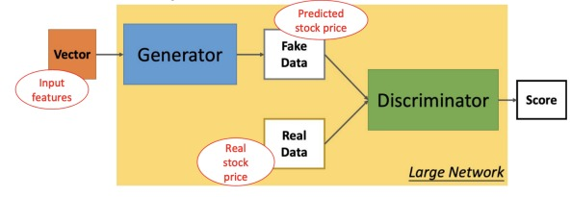
Algorithm Used
Generative Adversarial Network (GAN): Two neural networks compete with each other by using deep learning methods to become more accurate in their predictions. They create new data instances that resemble the training data. The generator tries to fool the discriminator by producing target output, and the discriminator tries to keep from being fooled by distinguishing true data from the output of the generator.

Slide 14
Algorithm Used
GAN Loss Functions: One for generator training and one for discriminator training. the generator and discriminator losses derive from a single measure of distance between probability distributions. Generator can only affect one term in the distance measure: the term that reflects the distribution of the fake data. So during generator training, we drop the other term, which reflects the distribution of the real data. The generator and discriminator losses look different in the end, even though they derive from a single formula.
Gradient Penalty: Does not suffer from issues like exploding gradient or vanishing gradient.
Root Mean Square Error (RMSE): Evaluating the quality of predictions. Derived by squaring the differences between known and unknown points, adding those together, dividing that by the number of test points, and then taking the square root of that result. The lower the RMSE the better the performance.

Slide 15


Slide 16
Algorithm Used
Gated Recurrent Unit (GRU): It helps solve the vanishing gradient problem. They can be trained to keep information from long ago, without removing information that is irrelevant to the prediction. It consists of two gates - update and reset gate.
Update Gate - helps the model to determine how much of the past information (from previous time steps) needs to be passed along to the future. A sigmoid activation function is applied to squash the result between 0 and 1.
Reset Gate - decides how much of the past information to forget.

Slide 17
Comparison of Models
After doing literature review we found that GAN model works better
than LSTM, since sometimes LSTM can lead to overfitting.
Regression Models don’t work properly with stocks data because of
Outliers or insufficient variables.
Model name | Rmse value
LSTM | 9.45
GAN | 3.2
Regression model | 121.6

Slide 18
Optimal Case
The optimal case in this scenario is to achieve real-time sentiment analysis of tweets for accurate and timely stock market predictions. To accomplish this, a combination of stream data processing and advanced sentiment analysis techniques can be employed.
Implementing stream data processing allows for continuous processing of incoming tweets in real-time, enabling quick reactions to changing sentiment patterns and providing up-to-the-minute insights.
Incorporating advanced sentiment analysis models like BERT or transformers enhances the accuracy and granularity of sentiment classification, improving the quality of data for stock market prediction.
Furthermore, deploying the system on scalable and efficient cloud-based infrastructure can handle the large volume of real-time data and ensure low latency processing. Regular model retraining and optimization based on fresh data will further enhance the system's accuracy and adaptability to evolving market dynamics.

Slide 19
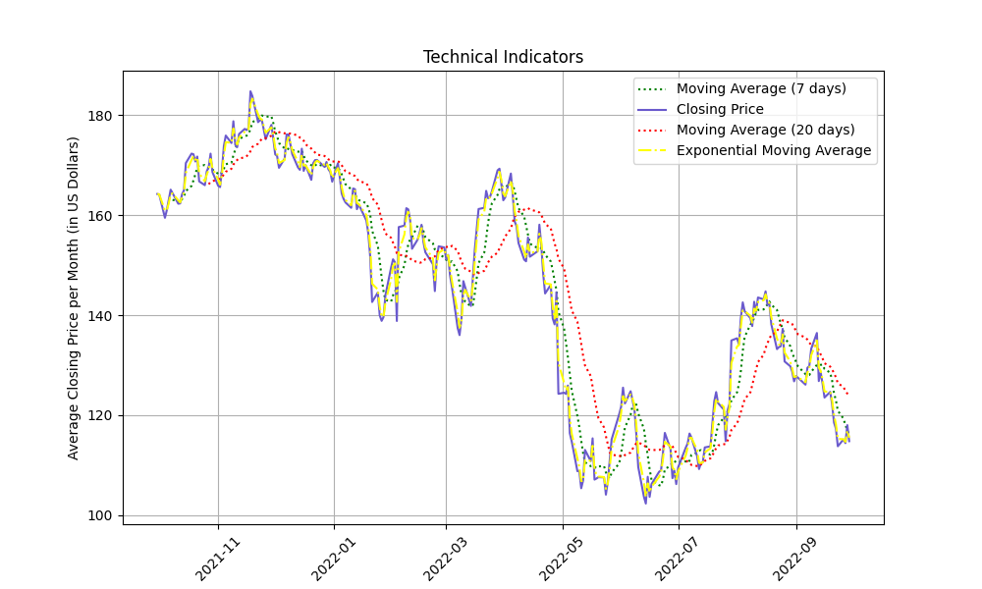
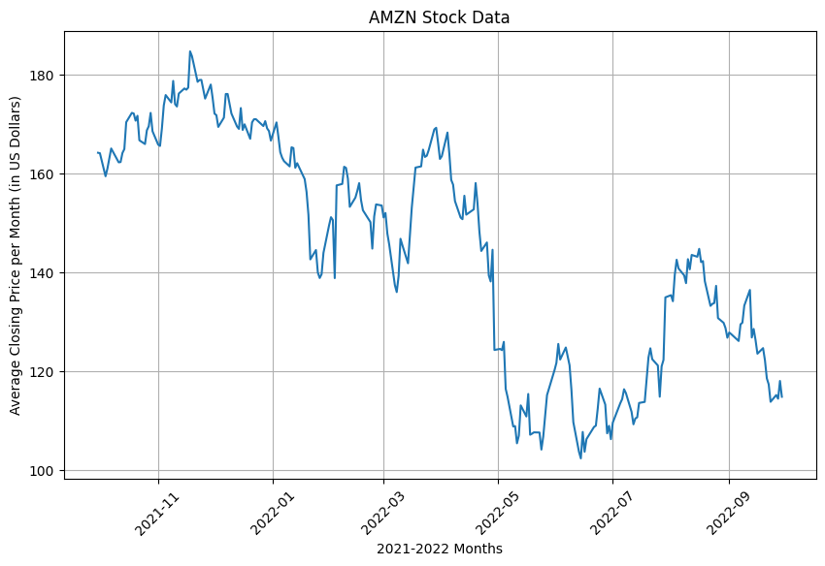
Diagrams

Slide 20
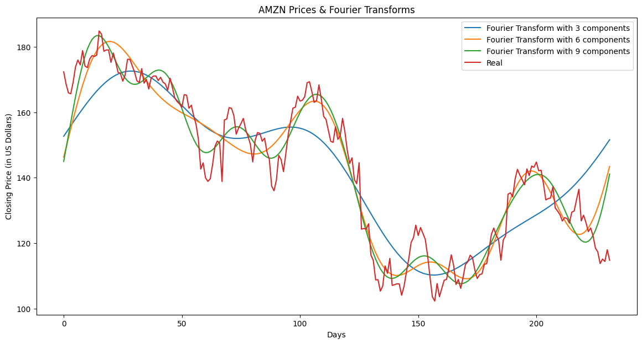
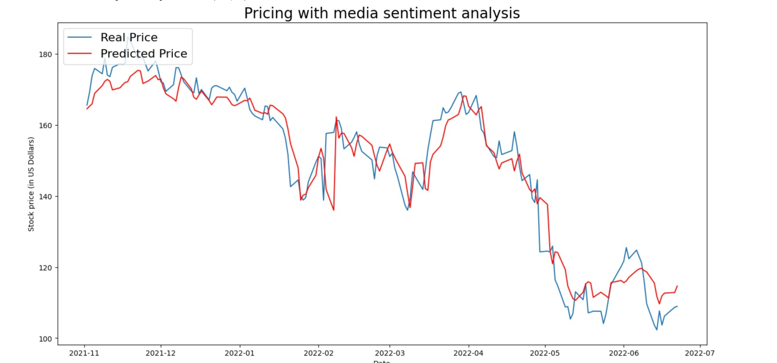
Diagrams

Slide 21

Challenges Faced
Noisy Data: Dealing with noisy and unstructured tweet data, including irrelevant information, spam, and non-standard language, which requires robust pre processing techniques.
Market Volatility: Dealing with the inherent volatility and unpredictability of the stock market, where sentiment analysis may not always be an accurate indicator of stock price movements.
Vanishing Gradient Problem: The discriminator gets too successful that the generator gradient vanishes and learns nothing.
Model Generalization: Ensuring that sentiment analysis and stock market prediction models generalize well to unseen data, as the dynamics of sentiment and market behaviour can vary over time.
Performance Metrics: Getting a high RMSE value.

Slide 22

Our Learning
Utilizing sentiment analysis provided valuable insights for stock market prediction.
Data pre processing is crucial to remove noise and prepare the tweet data for analysis.
Handling time series data with deep learning methods.
Correlation analysis helps identify relationships between sentiment and stock prices.
Hyperparameter Optimization.
Model deployment using Streamlit.
Team work.

Slide 23
Future Enhancements
Incorporating Advanced Sentiment Analysis Techniques: Explore and implement more advanced sentiment analysis techniques, such as deep learning-based models like BERT or transformers, to improve the accuracy and granularity of sentiment classification.
Sentiment Analysis of Non-English Tweets: Extend the project to include sentiment analysis of non-English tweets, utilizing language-specific models or translation techniques to broaden the scope of analysis and capture a more diverse range of sentiments.
Contextual Analysis: Incorporate contextual analysis techniques to consider the broader context of tweets, including user profiles, time of posting, and external events, to better understand and interpret sentiment in relation to stock market movements.
Incorporating Additional Data Sources: Integrate other relevant data sources, such as financial news articles, analyst reports, or macroeconomic indicators, to enrich the dataset and enhance the predictive power of the models.
Incorporating Real-Time News and Social Media Streams: Integrate real-time news and social media streams to provide up-to-the-minute sentiment analysis and stock market predictions, allowing users to respond quickly to changing market conditions.

Slide 24
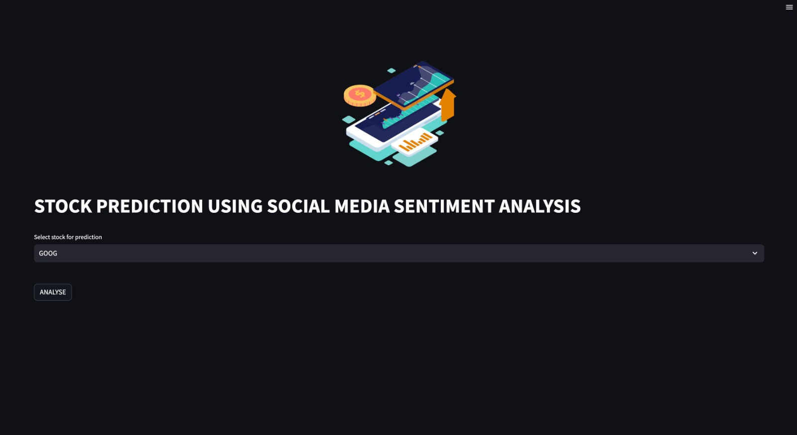
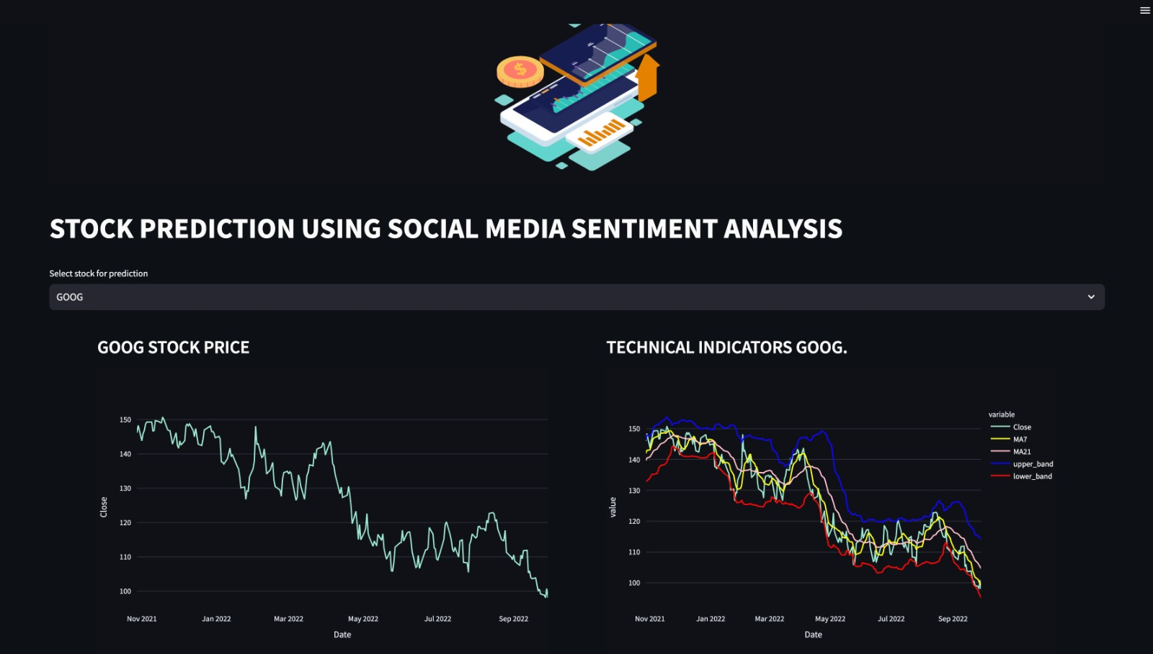
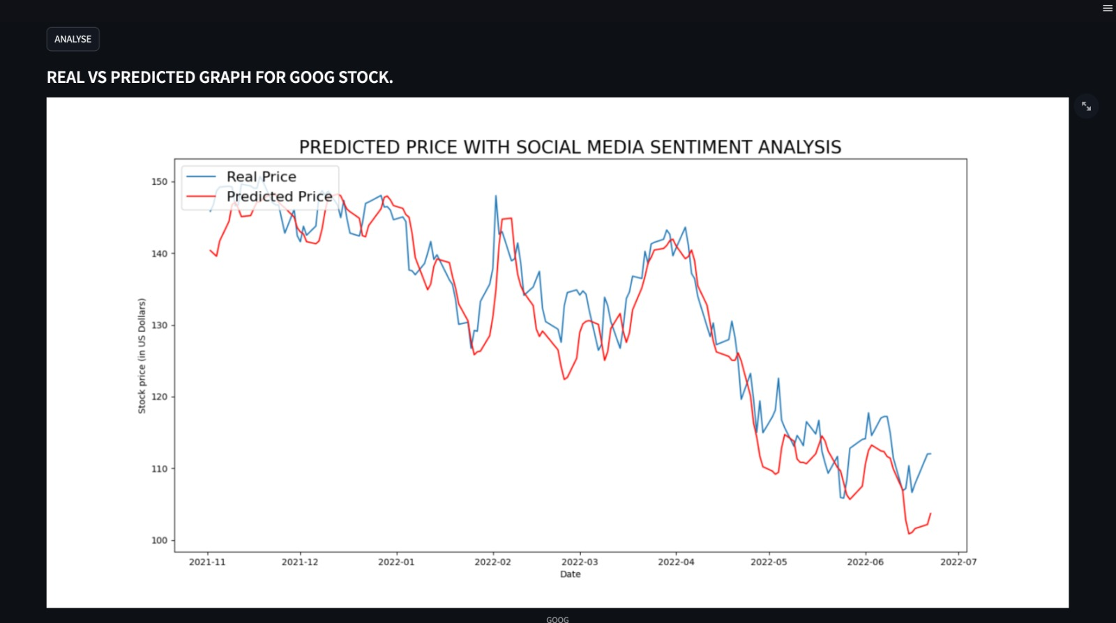
Demo

Slide 25
Group 15
Thank You

